Slide 1
Flight Price Prediction

Slide 2
Problem Statement-
Data Collection-
You have to scrape at least 1500 rows of flight details from different websites. (yatra.com, skyscanner.com, official websites of airlines, etc).
Model Building –
After collecting the data, you need to build a machine learning model.

Slide 3
Problem Understanding-
Anyone who has booked a flight ticket knows how unexpectedly the prices vary. The cheapest available ticket on a given flight gets more and less expensive over time. This usually happens as an attempt to maximize revenue based on -
1. Time of purchase patterns (making sure last-minute purchases are expensive)
2. Keeping the flight as full as they want it (raising prices on a flight which is filling up in order to reduce sales and hold back inventory for those expensive last-minute expensive purchases)
So, you have to work on a project where you collect data of flight fares with other features and work to make a model to predict fares of flights.

Slide 4
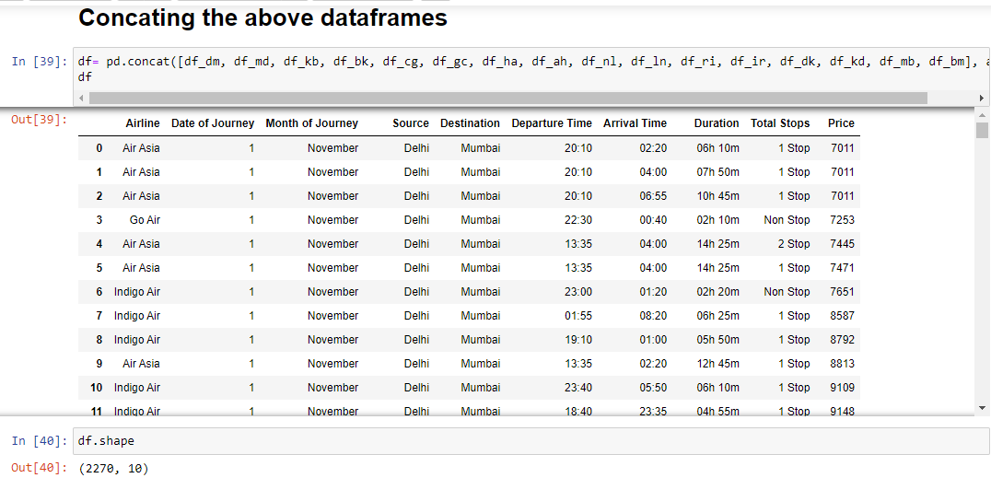
Data Collection
The data is scraped from 3 websites-
vimaansafar.com
yatra.com
makemytrip.com
2270 flight data is scraped from all the three websites.

Slide 5
Model Building
EDA Steps and Visualization

Slide 6
The web scraped data is saved onto an excel sheet
The excel datasheet is extracted and saved in a dataframe
The shape of the dataframe is checked-
There are 2270 rows and 10 columns
The columns are as follows-
Airline
Date of Journey
Month of Journey
Source
Destination
Departure Time
Arrival Time
Duration
Total Stops
Price

Slide 7
The data type of each column is-
Airline - object
Date of Journey - int64
Month of Journey - object
Source - object
Destination - object
Departure Time - object
Arrival Time - object
Duration - object
Total Stops - object
Price - object
The null values are checked. The whitespaces, and dashes (‘—’) are replaced by null values-
There are no null values

Slide 8
The data visualization, value counts and encoding of object data type into numeric form for each column

Slide 9
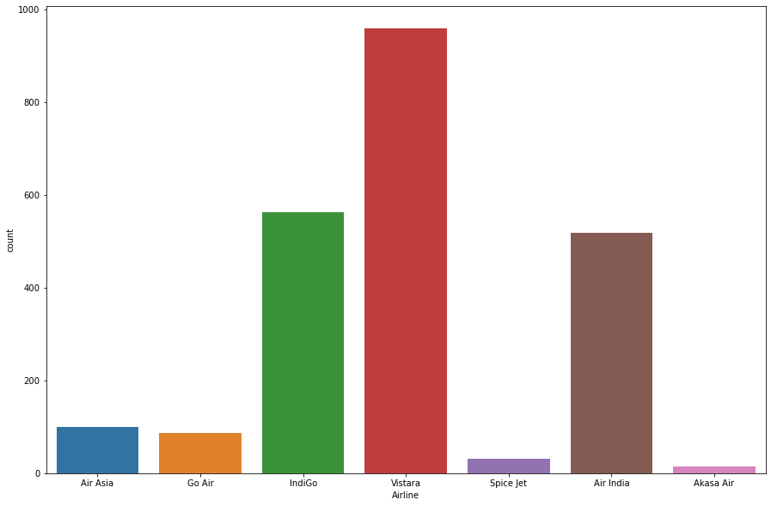
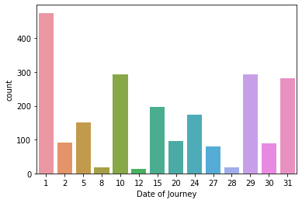
Airline
Date of Journey
Replacing redundant airline names
475 flights depart on the 1st date of the month
294 flights depart on the 10th date of the month
293 flights depart on the 29th date of the month
282 flights depart on the 31st date of the month
197 flights depart on the 15th date of the month
173 flights depart on the 24th date of the month
151 flights depart on the 5th date of the month
96 flights depart on the 20th date of the month
2 91 flights depart on the 2nd date of the month
89 flights depart on the 30th date of the month
79 flights depart on the 27th date of the month
19 flights depart on the 28th date of the month
18 flights depart on the 8th date of the month
13 flights depart on the 12th date of the month
959 flights are Vistara flights
562 flights are Indigo flights
518 flights are Air India flights
100 flights are Air Asia flights
86 flights are Go Air flights
31 flights are Spice Jet flights
Air 14 flights are Akasa Air flights
Encoding object data in numeric using Label Encoder

Slide 10
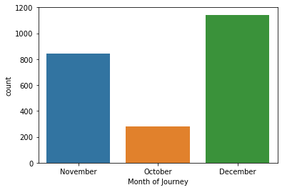
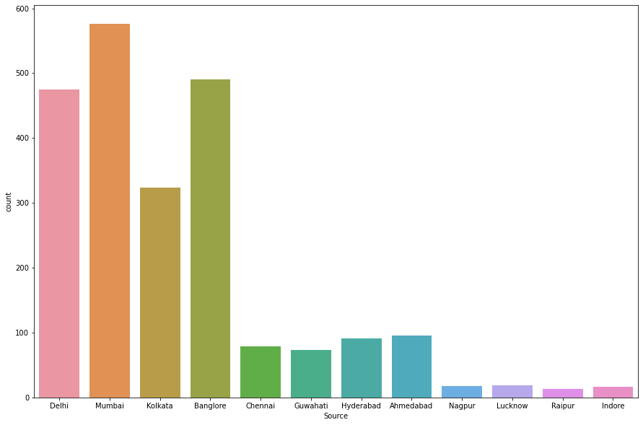
Month of Journey
Source
1143 flights depart in December
845 flights depart in November
282 flights depart in October
576 flights depart from Mumbai
490 flights depart from Banglore
475 flights depart from Delhi
324 flights depart from Kolkata
96 flights depart from Ahmedabad
91 flights depart from Hyderabad
79 flights depart from Chennai
73 flights depart from Guwahati
19 flights depart from Lucknow
18 flights depart from Nagpur
16 flights depart from Indore
13 flights depart from Raipur
Encoding object data in numeric using Label Encoder
Encoding object data in numeric using Label Encoder

Slide 11
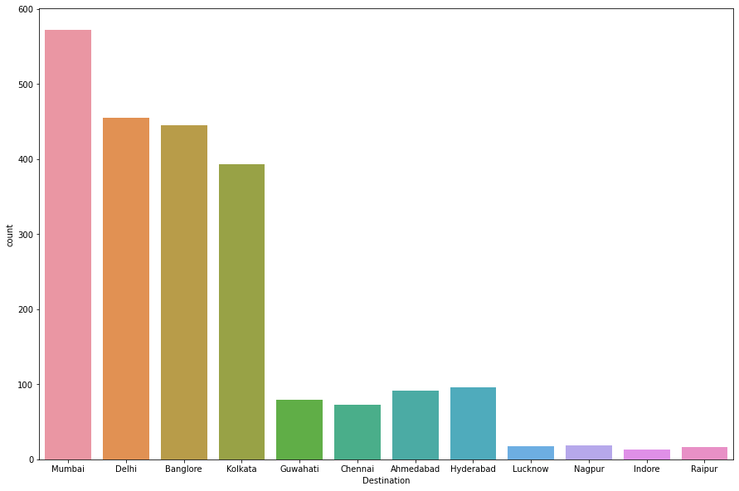
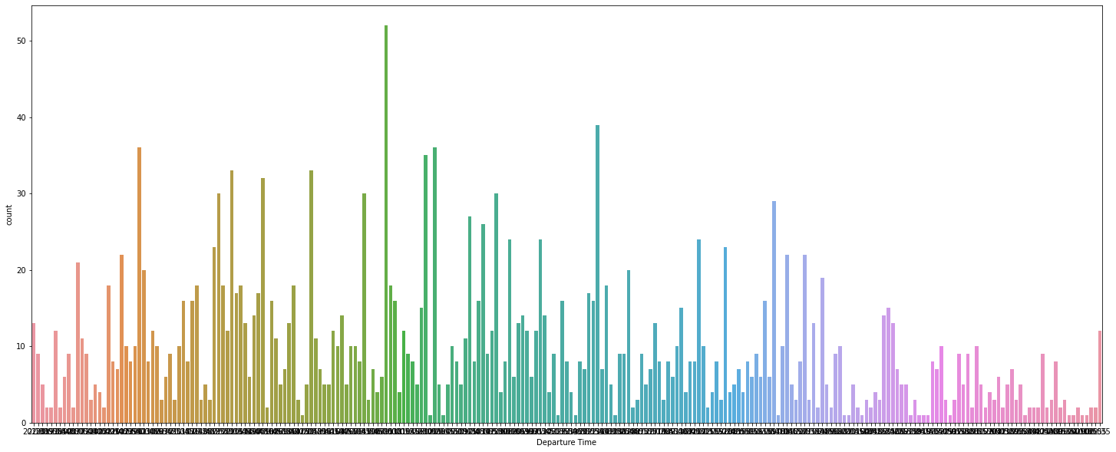
Destination
Departure Time
572 flights arrive at Mumbai
455 flights arrive at Delhi
445 flights arrive at Bangalore
393 flights arrive at Kolkata
96 flights arrive at Hyderabad
91 flights arrive at Ahmedabad
79 flights arrive at Guwahati
73 flights arrive at Chennai
19 flights arrive at Nagpur
18 flights arrive at Lucknow
16 flights arrive at Raipur
13 flights arrive at Indore
Majority of the flights depart in the morning between 6.00 to 10.00
Converting time to continous number
Encoding object data in numeric using Label Encoder

Slide 12
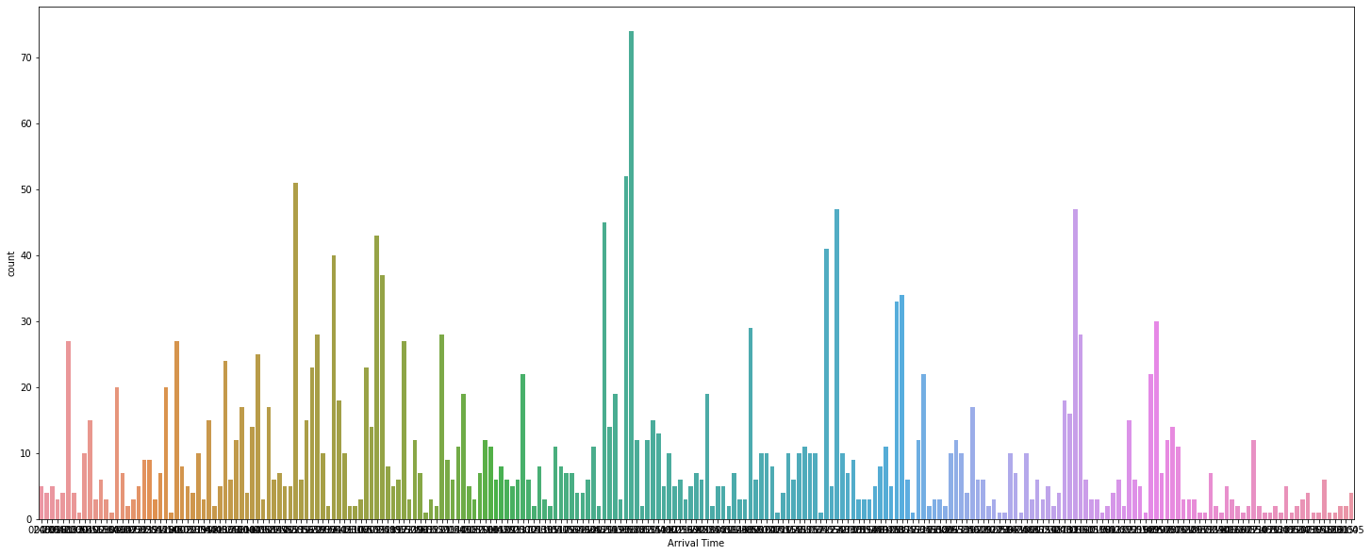
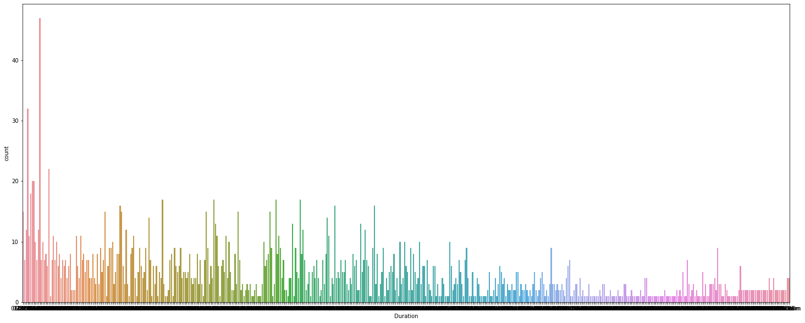
Arrival Time
Duration
Majority of the flights arrive in the evening between 7.00 to 12.00
Majority of the flights have a duration of 2-6 hours
Converting time to continous number
Converting time to continous number

Slide 13
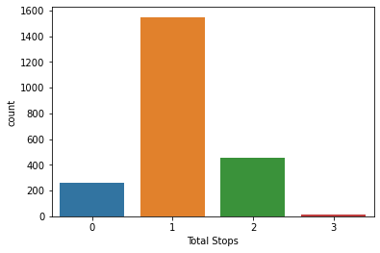
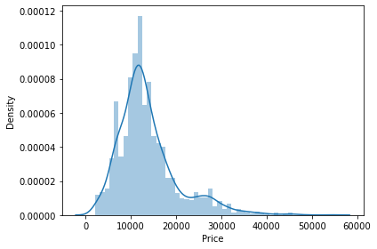
Total Stops
Price
Replacing redundant stop names and converting into integer type
Replacing ‘,’ in price and conerting into integer type
1548 flights have 1(one) stop
451 flights have 2(two) stops
259 flights are non-stop
12 flights have 3(three) stops
Majority of the flights have a price of 7000 - 14000

Slide 14
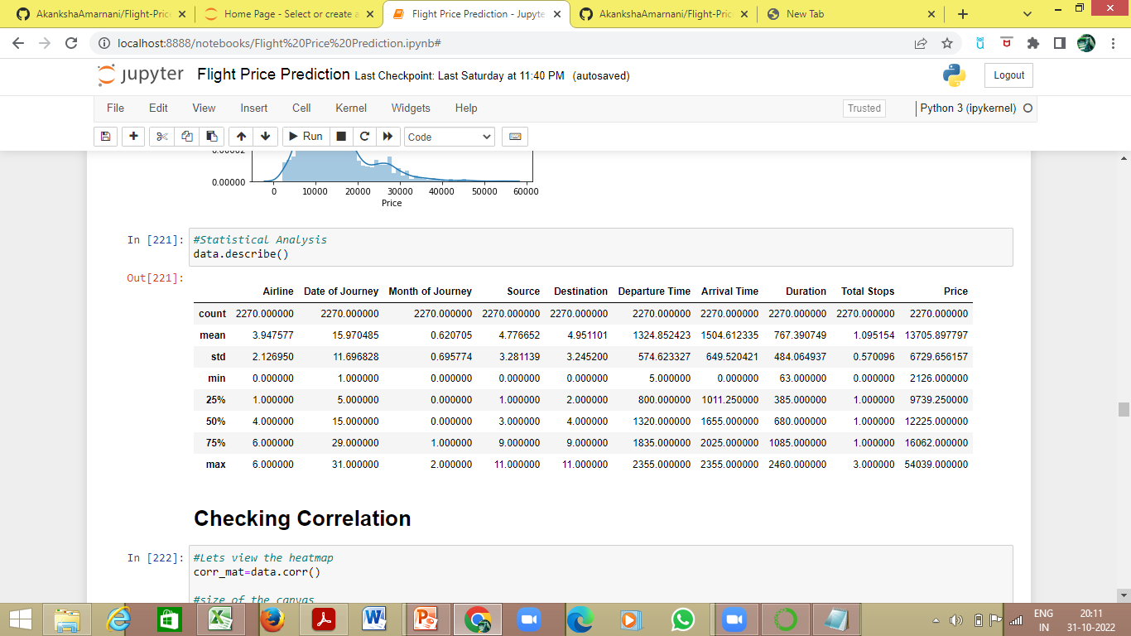
Statistical analysis using describe method-

Slide 15
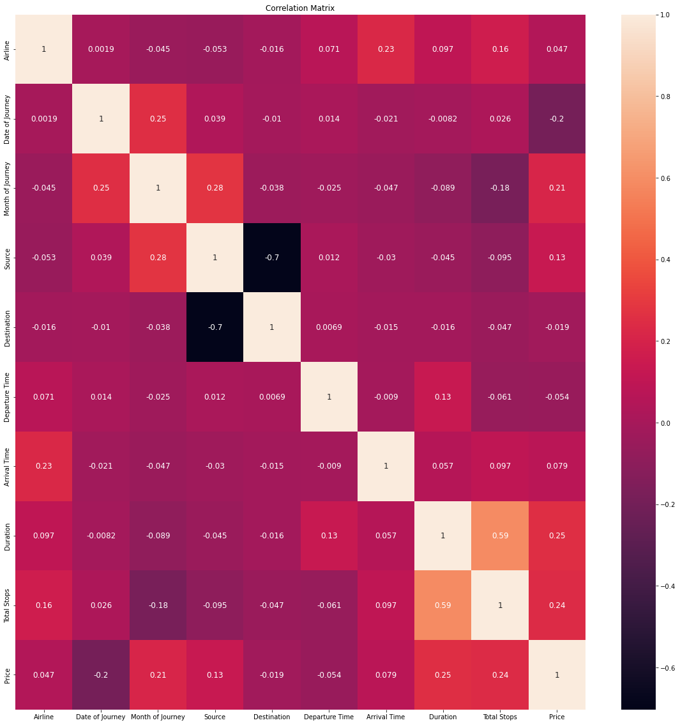
The Correlation Matrix using heatmap

Slide 16
Correlation between the columns and the label ‘Price’ using corr method-
Duration : 0.248551
Total Stops : 0.235351
Month of Journey : 0.209234
Source : 0.131165
Arrival Time : 0.078749
Airline : 0.047292
Destination : -0.019074
Departure Time : -0.054397
Date of Journey : -0.197196
Duration is 24.85% positively correlated to ‘Price’
Total Stops is 23.53% positively correlated to ‘Price’
Month of Journey is 20.92% positively correlated to ‘Price’
Source is 13.11% positively correlated to ‘Price’
Arrival Time is 7.87% positively correlated to ‘Price’
Airline is 4.73% positively correlated to ‘Price’
Destination is 1.91% negatively correlated to ‘Price’
Departure Time is 5.43% negatively correlated to ‘Price’
Date of Journey is 19.72% negatively correlated to ‘Price’

Slide 17
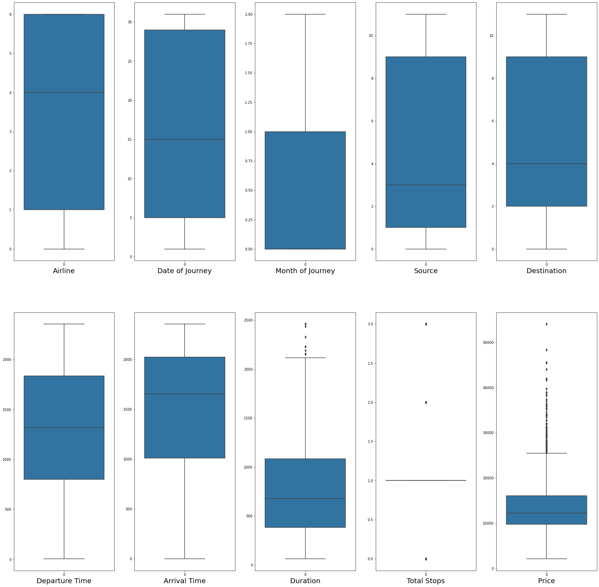
Visualizing outliers using boxplot method-

Slide 18
Removing outliers using zscore method-
On removing the outliers the data loss is 2.3%, which is acceptable, hence outliers are removed
The dataset is divided into x(features) and y (label)-
The x contains all the features other than the label ‘Price’
The y contains only the label ‘Price’

Slide 19
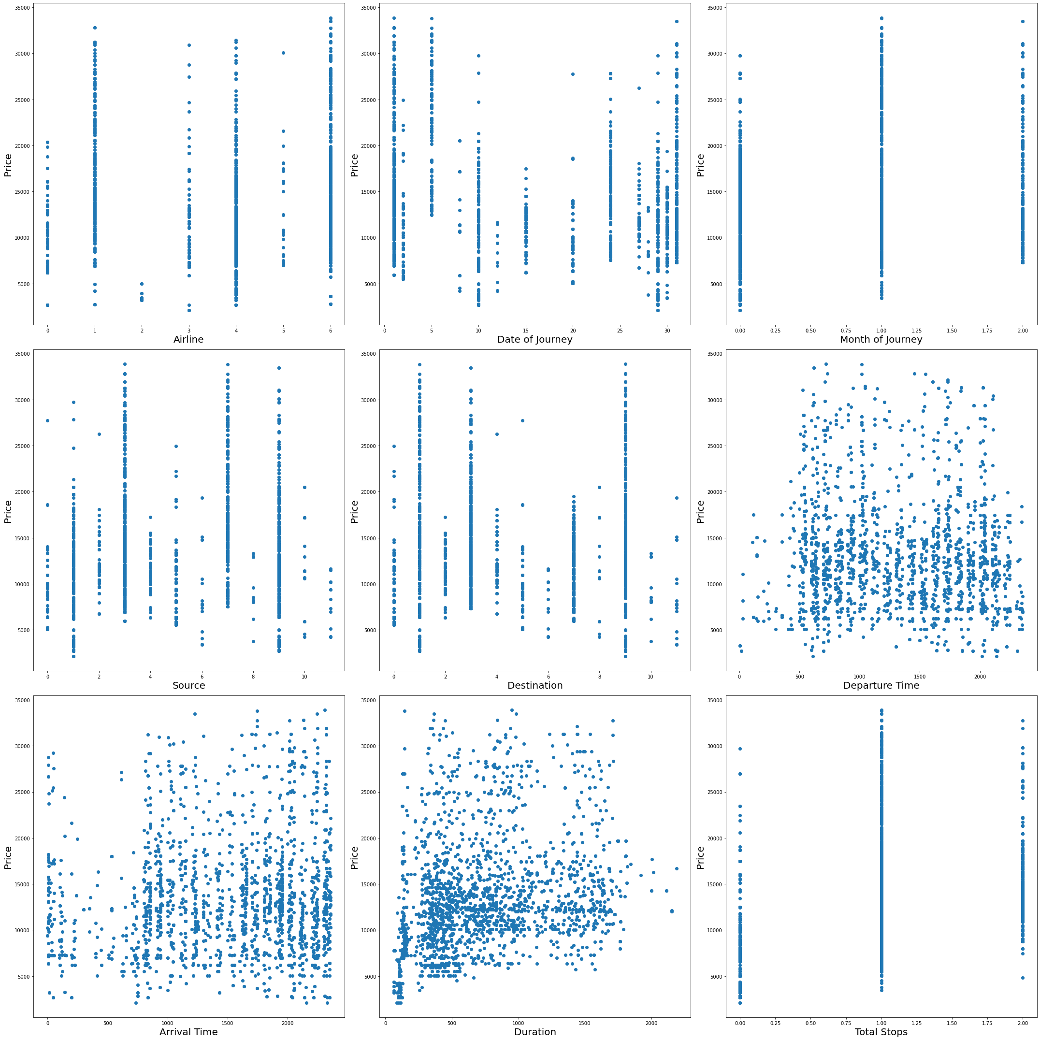
Visualizing relationship between features and label-

Slide 20
The skewness observed in graphical analysis was confirmed by using the skew method-
Month of Journey : 0.693280
Duration : 0.548951
Source : 0.145235
Destination : 0.051229
Total Stops : 0.030756
Departure Time : -0.004913
Date of Journey : -0.013968
Airline : -0.524608
Arrival Time : -0.610788
This skewness was removed using the power transformer
The x(features) were scaled using the Standard Scaler
The dataset was divided into train and test set using train test split and the best random state was found to be 1

Slide 21
The train and test data were applied on different models as follows

Slide 22
Linear Regression Model
The R2 score for target test and pred_test(data predicted on features_test) is 28.98%
Upon cross-validation it was observed that the number of folds did not have such impact on the accuracy and cv score. So cv=9 is selected. Here we have handled the problem of the overfitting and the underfitting by checking the training and testing score
The graph between Actual Price and Predicted Price depicts the best fit line which passes through maximum of the points, hence suggesting that the model works well-

Slide 23
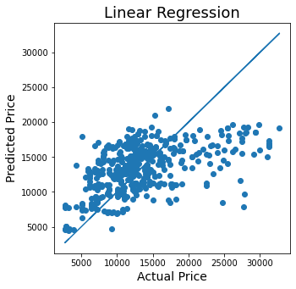

Slide 24
The Linear Regression Model is Lasso regularized with the aid of GridSearchCV
The best parameters for alpha and random_state are found as follows-
alpha: 10
random_state: 0
Applying the above found best parameters on Lasso regularized Linear Regression Model, the following was obtained-
R2 score for target_test and pred_test(data predicted on features_test) : 29.05%
CV score : -13.12%

Slide 25
Random Forest Regressor Model
Random Forest Regressor Model is hyperparameter tuned using GridSearchCV
The best parameters for criterion and max_features are found as follows-
criterion: mse
max_features: auto
Applying the above found best parameters on Random Forest Regressor Model, the following was obtained-
R2 score for target_test and pred_test (data predicted on features_test) : 69.55%
CV score : -69.30%

Slide 26
Ada Boost Regressor Model
Ada Boost Regressor Model is hyperparameter tuned using GridSearchCV
The best parameters for n_estimators and learning_rate are found as follows-
learning_rate: 0.01
n_estimators: 87
Applying the above found best parameters on Ada Boost Regressor Model, the following was obtained-
R2 score for target_test and pred_test(data predicted on features_test) : 48%
CV score : 19.22%

Slide 27
Model | R2 score for target_test and pred_test (data predicted on features_test) | CV score
Linear Regression Model | 29.05% | -13.12%
Random Forest Regressor Model | 69.55% | -69.30%
AdaBoost Regressor Model | 48% | 19.22%
The R2 score of Random Forest Regressor is 69.55% and CV score of Random Forest Regressor is -69.30%
This is the best working model and is finalized
This model can be used to predict the price of the flights

